Slide 1



Predicting Insurance Drug Spending
IS 670 – Machine learning for Business Analytics
Prof. Moy Patel
Presented by: Group 2
Dhruti - 033694932
Aditya - 033718085
Adhi - 031536984
Vijay - 033696466
Purav - 032255195
Notes:
"Hello everyone, my name is Adhi, and along with my teammates Dhruti, Aditya, Vijay, and Purav, we are excited to present our project, 'Predicting Insurance Drug Spending.' This project aims to forecast drug costs using machine learning, providing valuable insights for healthcare stakeholders.

Slide 2


OUTLINE
Introduction
Problem statement
Dataset selection and Business Understanding
CRISP-DM
All about Models- Implementation, Evaluation & Comparison
Final model
Conclusion
Citations & References
Notes:
Here's a quick overview of our presentation today. We'll cover the introduction, problem statement, dataset selection, CRISP-DM methodology, our models and evaluations, the final model we chose, and finally, our conclusion and references. Let's get started.

Slide 3
Introduction
Accurate prediction of Insurance Drug Spending is essential for budget planning, reimbursement decisions, and policy-making in healthcare.
This project analyzes Medicare Part D claims data (2018–2022) using machine learning to forecast average drug spending per dosage unit.
Problem Statement
To develop a predictive model that can estimate future drug cost behavior, detect cost outliers, and help healthcare stakeholders make data-driven decisions.
We aim to use machine learning to automate analysis traditionally done manually, improving speed and accuracy.
Notes:
Accurate prediction of insurance drug spending is essential for budget planning, reimbursement decisions, and policy-making in healthcare. Our project focuses on analyzing Medicare Part D claims data from 2018 to 2022, using machine learning to forecast average drug spending per dosage unit. Our goal is to automate this traditionally manual analysis, improving both speed and accuracy
Our main objective is to develop a predictive model that estimates future drug cost behavior, identifies cost outliers, and supports data-driven decision-making for healthcare stakeholders. This approach aims to make healthcare cost analysis more efficient and accurate, ultimately improving financial sustainability

Slide 4
Business Importance
Helps insurers and healthcare systems control rising drug costs
Supports decision-making in benefit design, price negotiations, and reimbursement planning
Enables identification of high-cost outlier drugs for closer monitoring
Notes:
Predicting drug spending is critical for insurers and healthcare systems as it supports decisions in benefit design, price negotiations, and reimbursement planning. It also helps identify high-cost drugs for closer monitoring, ultimately contributing to financial stability in public programs like Medicare.

Slide 5
All About the Data
Source: data.gov – Medicare Part D Spending by Drug
Records: 13,889 | Features: 46
Years Covered: 2018 to 2022
Includes: Brand name, claims, spending, dosage units, outlier flags, CAGR, etc.
Notes:
For our analysis, we used the Medicare Part D Spending by Drug dataset from data.gov. It includes 13,889 records with 46 features, covering the years 2018 to 2022. This dataset provides details like brand name, claims, spending, dosage units, and more, giving us a comprehensive view of drug spending over time

Slide 6
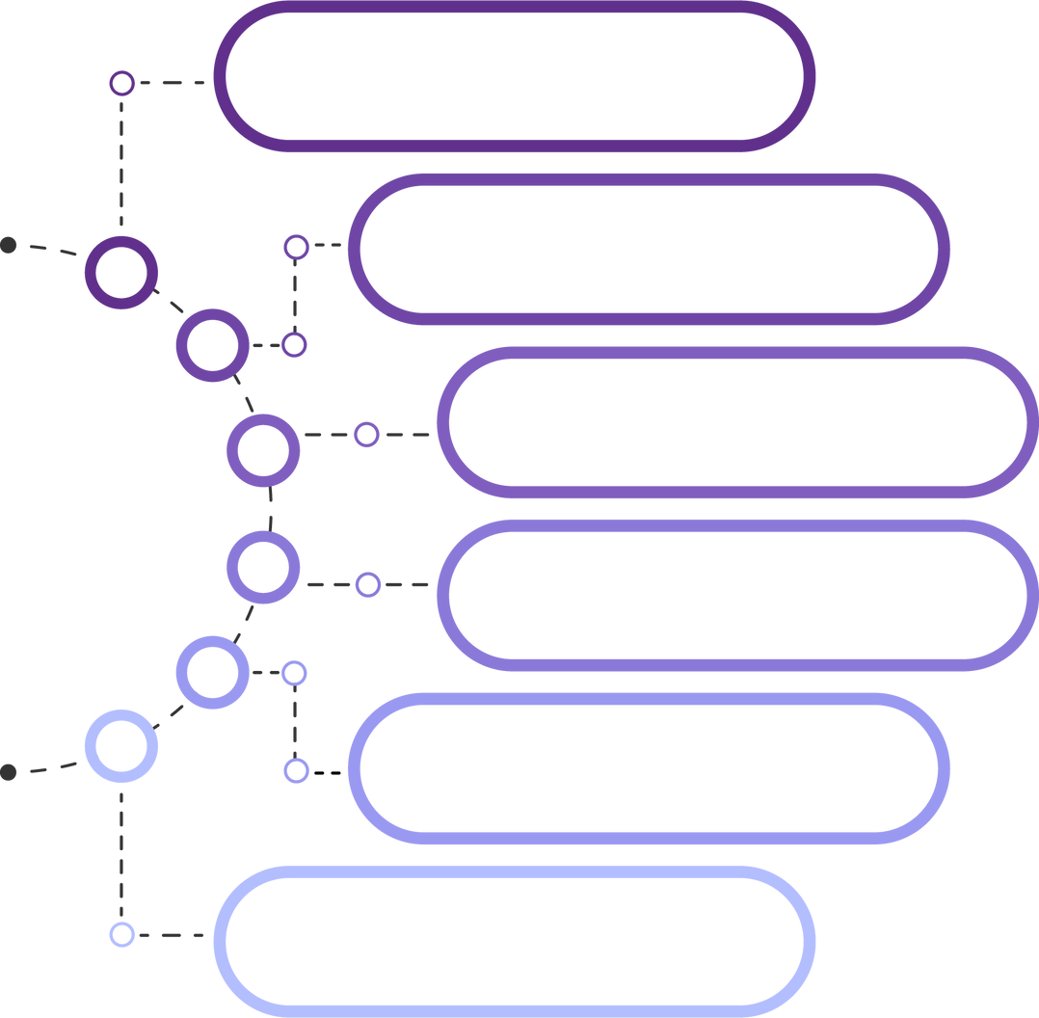

BUSINESS UNDERSTANDING
DATA PREPARATION
DATA MODELING
Crisp- DM
DATA UNDERSTANDING
EVALUATION
DEPLOYMENT
Notes:
Our project follows the CRISP-DM methodology, which stands for Cross-Industry Standard Process for Data Mining. This structured approach includes six key phases: business understanding, data understanding, data preparation, modeling, evaluation, and deployment. It provided a clear framework for our analysis, ensuring each step was thoroughly addressed.

Slide 7
The rising cost of prescription drugs is a major concern for healthcare systems and insurers.
This project aims to support cost transparency and policy planning by predicting drug prices and claims using machine learning.
Key Business Goals:
Enable proactive budget planning for insurers and hospitals
Identify high-cost or anomalous drugs early for cost control
Support data-driven decisions in pricing negotiations and reimbursement policies
Help improve financial sustainability in public programs like Medicare
Business Understanding
Notes:
Slide 7: Business UnderstandingThe rising cost of prescription drugs is a growing concern for healthcare systems and insurers.In this project, we used machine learning to predict drug prices and claims, aiming to support cost transparency and better planning.Our business goals were to:• Help insurers and hospitals plan budgets• Detect costly or unusual drugs early• Support data-driven pricing and reimbursement decisions• And promote financial sustainability in public programs like Medicare

Slide 8
Data Preparation
To prepare the dataset for modeling, the following steps were taken:
Missing Values
Dropped columns with more than 50% missing data
Removed remaining rows with any null values
Duplicate Handling
Duplicate entries were identified and removed to avoid bias
Feature Review
Categorical features (e.g., brand name) were excluded from modeling
Focused on numerical cost-related features
Outlier Awareness
Outliers were retained and later handled using log transformation, ensuring model robustness
This preparation ensured a clean and consistent dataset for accurate prediction.
Notes:
Slide 8: Data PreparationWe began with a dataset containing 13,889 rows and 46 columns.• We dropped columns with over 50% missing values• Then removed rows with any remaining nulls• And cleared duplicate entries to avoid biasWe also excluded categorical features like brand names and kept only numerical data related to drug spending.Finally, instead of removing outliers, we planned to handle them later using log transformation to make our model more robust.This gave us a clean and consistent dataset ready for accurate prediction.

Slide 9
Data Modeling
Data
Understanding
We trained and compared several machine learning models to forecast drug costs and detect outliers:
K-Nearest Neighbors Regressor (KNN) – Distance-based model; performance depends on optimal k
Random Forest Regressor – Ensemble method offering robust predictions
XGBoost – Powerful gradient boosting model
LightGBM – Fastest and most accurate model in our analysis
Linear Regressor: A simple and interpretable baseline model
Decision Tree Regressor: A tree-based model that captures non- linear relationships
We explored the structure and contents of the Medicare Part D dataset:
Dataset Shape: 13,889 rows × 46 columns
Data Types:
Numerical: Spending, dosage units, claims, beneficiaries
Categorical: Brand name, generic name, manufacturer
Target Variable:
Avg_Spnd_Per_Dsg_Unt_Wghtd_2022 (Average spending per dosage unit in 2022)
Feature Insights:
Strong year-to-year correlation among cost metrics
Categorical fields were excluded from modeling
Understanding these patterns helped in selecting relevant features for accurate predictions.
Notes:
After cleaning the data, we explored it further.The dataset included 13,889 rows and mostly numerical features.Our target variable was the average spending per dosage unit in 2022.We noticed strong correlation between cost values across years, which helped us select important features.Then we trained and compared several models:• KNN, Random Forest, XGBoost, LightGBM, Linear Regression, and Decision Tree RegressorThis helped us evaluate performance and pick the best model for forecasting drug costs.

Slide 10
Evaluation
Deployment
We evaluated the models using standard performance metrics:
Evaluation Metrics:
R² Score (Coefficient of Determination) – Measures how well the predictions approximate actual values
Mean Absolute Error (MAE) – Average of absolute differences between predicted and actual values; easy to interpret
Root Mean Squared Error (RMSE) – Penalizes larger errors more than MAE; useful for understanding prediction variability
Model Insights:
LightGBM had the best balance of precision, recall, and accuracy
XGBoost was a strong alternative, especially for detecting cost anomalies
Simpler models like Logistic Regression performed moderately but lacked robustness
Goal: Make the model usable in real-world decision-making systems for healthcare cost forecasting.
Deployment Strategy:
Model will be deployed via a web-based interface
Healthcare analysts can input new drug claim data and get predicted cost per dosage unit
Backend powered by the trained LightGBM model
Benefits:
Enables real-time analysis of new drugs
Supports policy planning, pricing audits, and budget forecasting
Scalable for integration into insurance and public health platforms
Notes:
We evaluated our models using three main metrics:• R² score, which shows how well the predictions match the actual values• MAE, which tells us the average error• And RMSE, which puts more weight on bigger errorsThese metrics helped us compare the models fairly and choose the one that best fits our prediction goal.This would support real-time analysis, improve budget planning, and could be used in insurance and healthcare systems.

Slide 11

MODELS

Slide 12
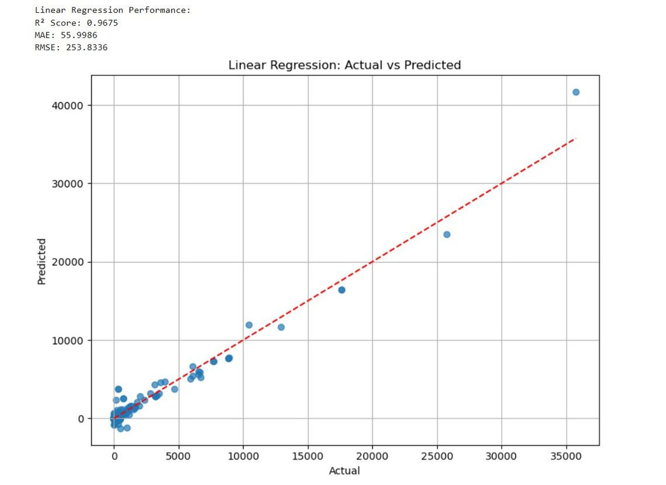
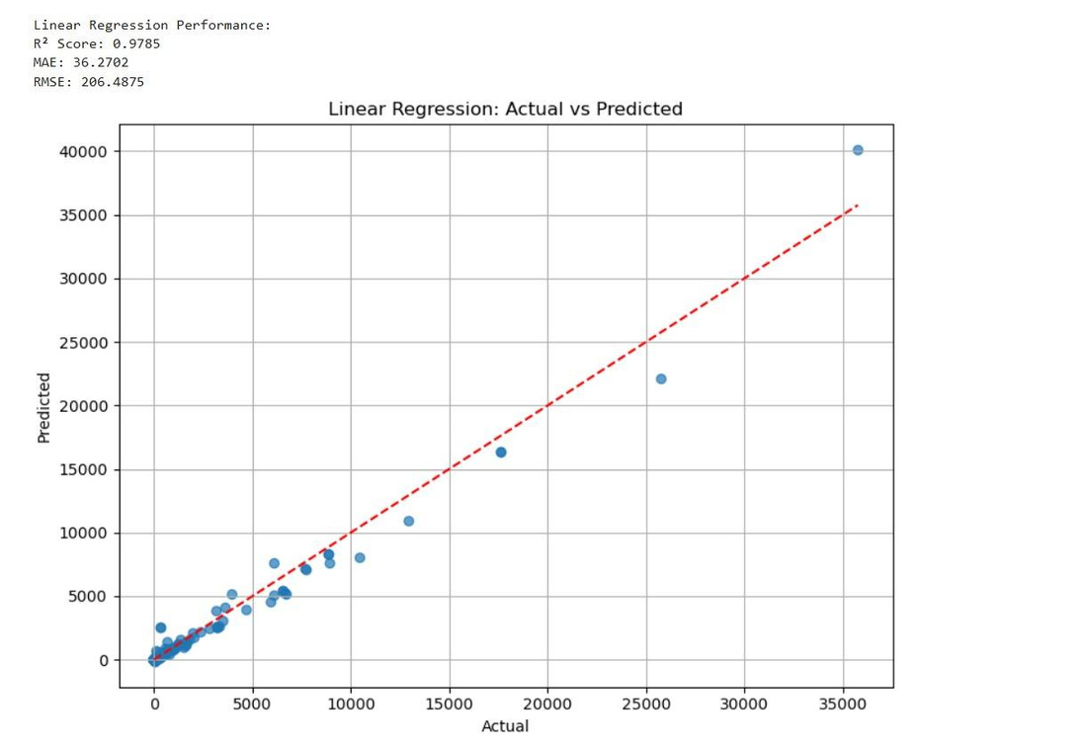
Linear Regression
Before Tuning
After Tuning
Notes:
We trained a Linear Regression model using features selected based on correlation with the target variable. Initially, we used the top 8 correlated features, which gave us decent performance. Then, we retrained the model using only the top 4 features, which improved the evaluation metrics (e.g., lower RMSE, higher R²).
This change helped the model by reducing noise and multicollinearity, making it simpler and more focused on the most predictive inputs.

Slide 13
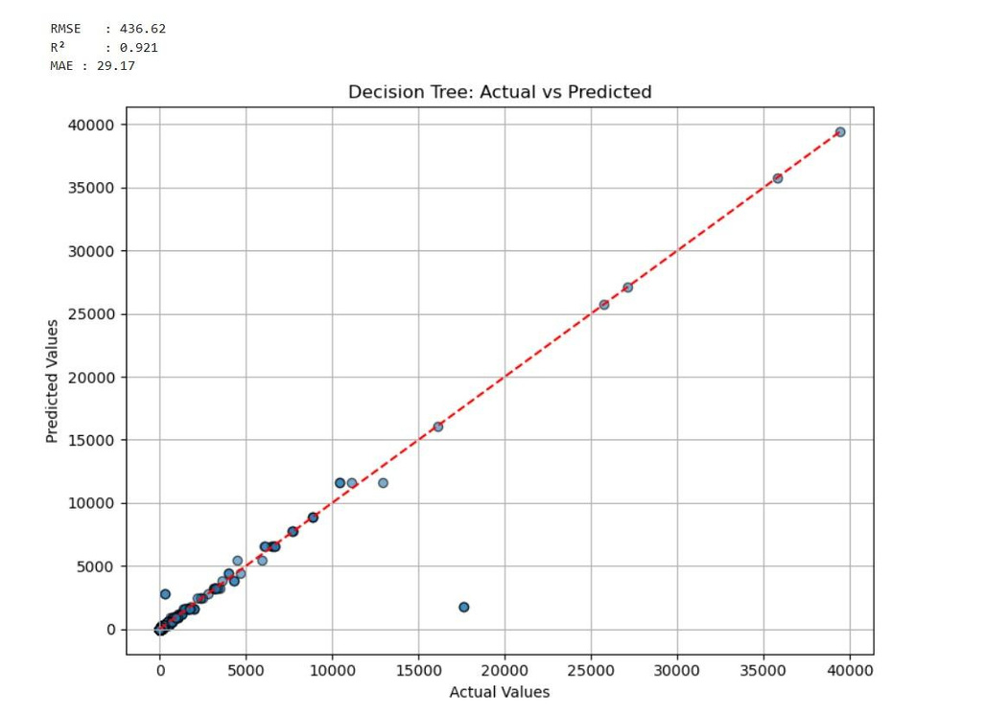
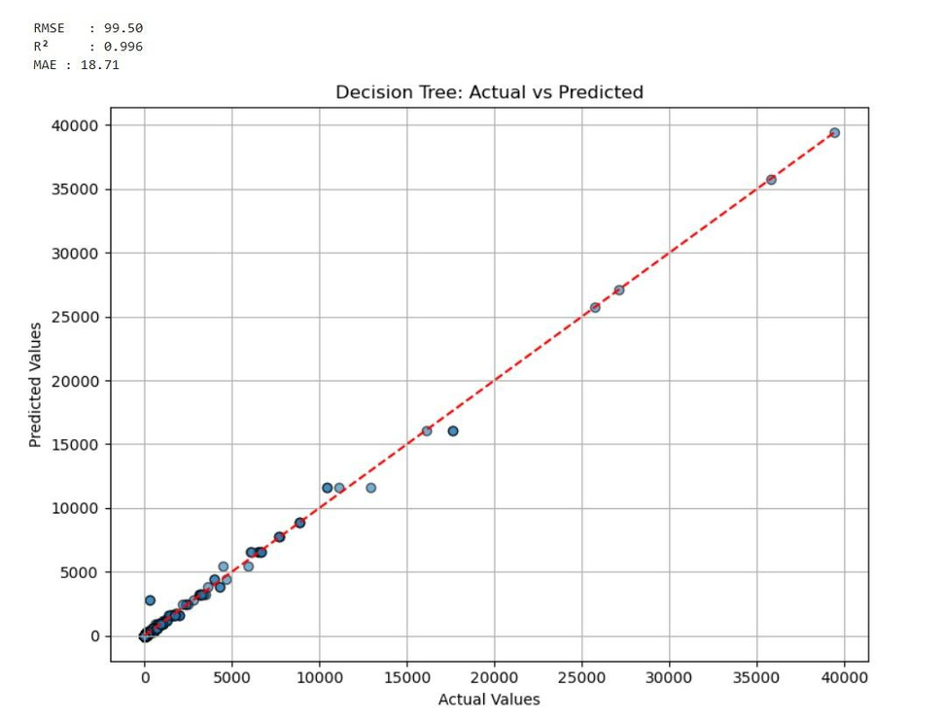
Decision Tree Regressor
Before Tuning
After Tuning
Notes:
We built a Decision Tree Regressor using features selected by their correlation with the target. In the first run, we used the top 8 correlated features, and in the second, we reduced it to the top 4.
Using fewer, more relevant features improved the model's performance by reducing overfitting and making the tree structure simpler and more generalizable. This led to better evaluation scores, showing that a more focused feature set can boost model effectiveness.

Slide 14
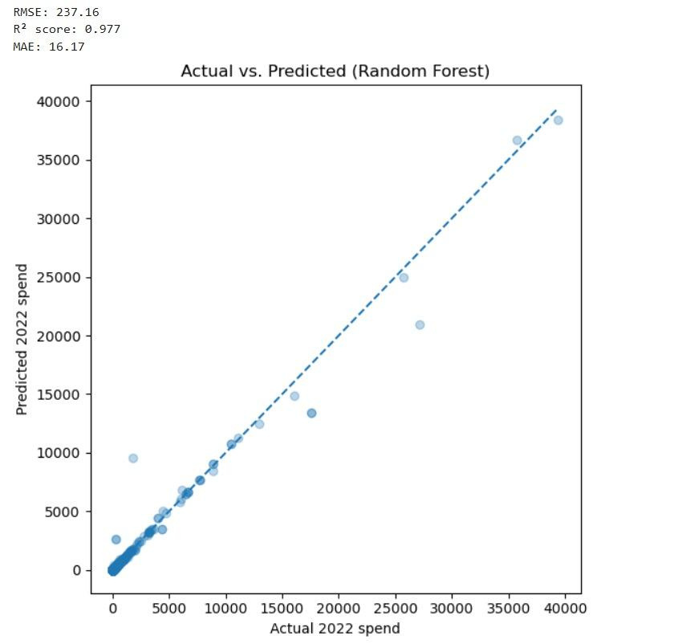
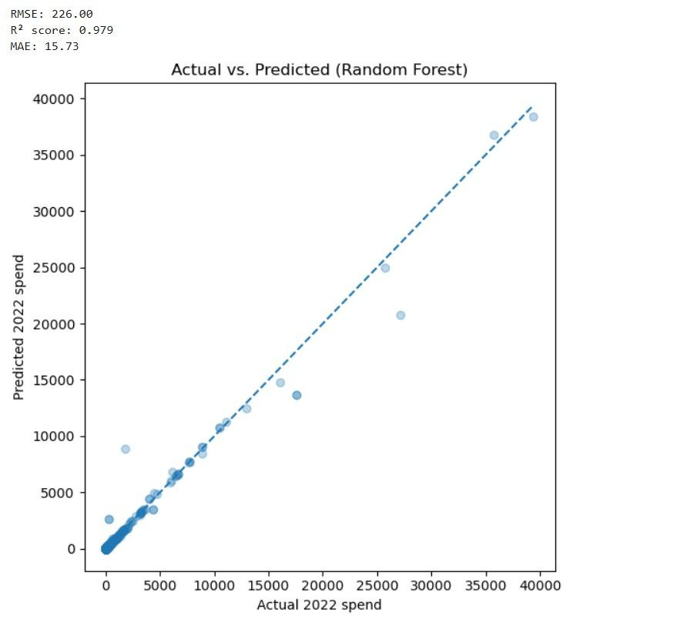
Random Forest Regressor
Before Tuning
After Tuning
Notes:
We experimented with different values for the n_estimators parameter, which controls the number of decision trees in the Random Forest. Starting from 150, we tested multiple values and observed how they affected model performance.
Eventually, setting n_estimators to 250 gave us the best results in terms of accuracy and error metrics. Increasing the number of trees improved stability and reduced variance, helping the model generalize better.

Slide 15
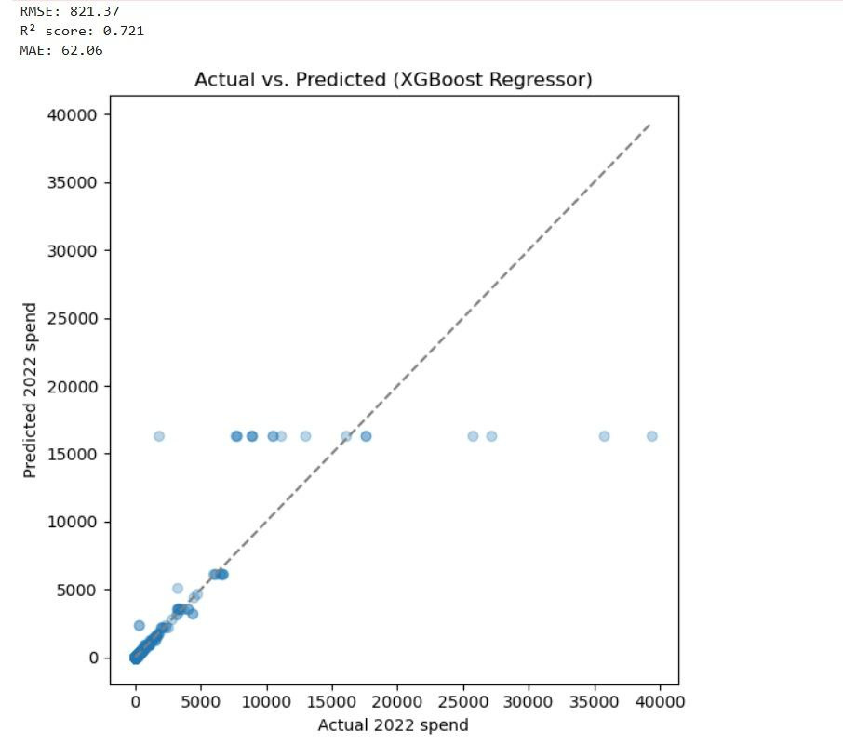
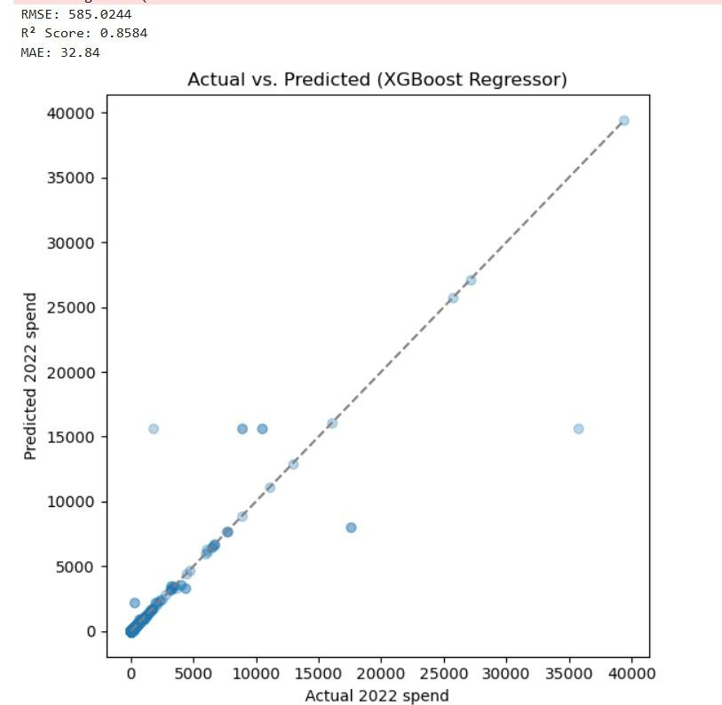
XG Boost
Before Tuning
After Tuning
Notes:
n_estimators=150, learning_rate=0.1 n_estimators=650, learning_rate=0.3
n_estimators defines the number of boosting rounds (trees). More trees can capture more complex patterns.
learning_rate controls how much each tree contributes to the final prediction. A higher rate (0.3) helps the model learn faster.

Slide 16
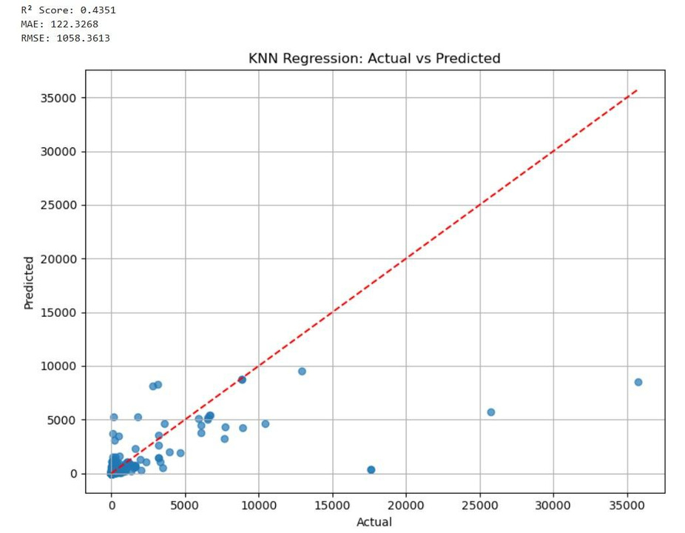
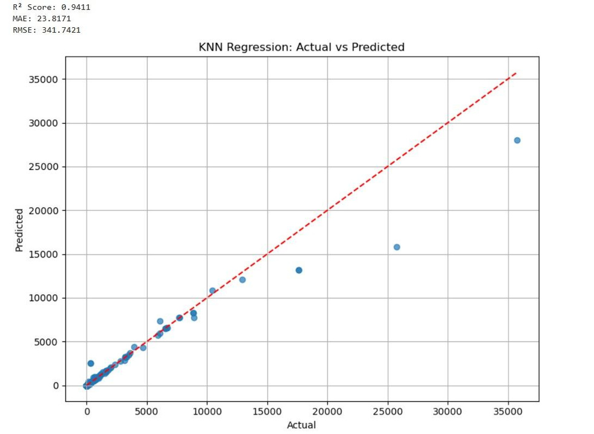
K-NN Regressor
Before Tuning
After Tuning
Notes:
Changed top 8 to top 4

Slide 17
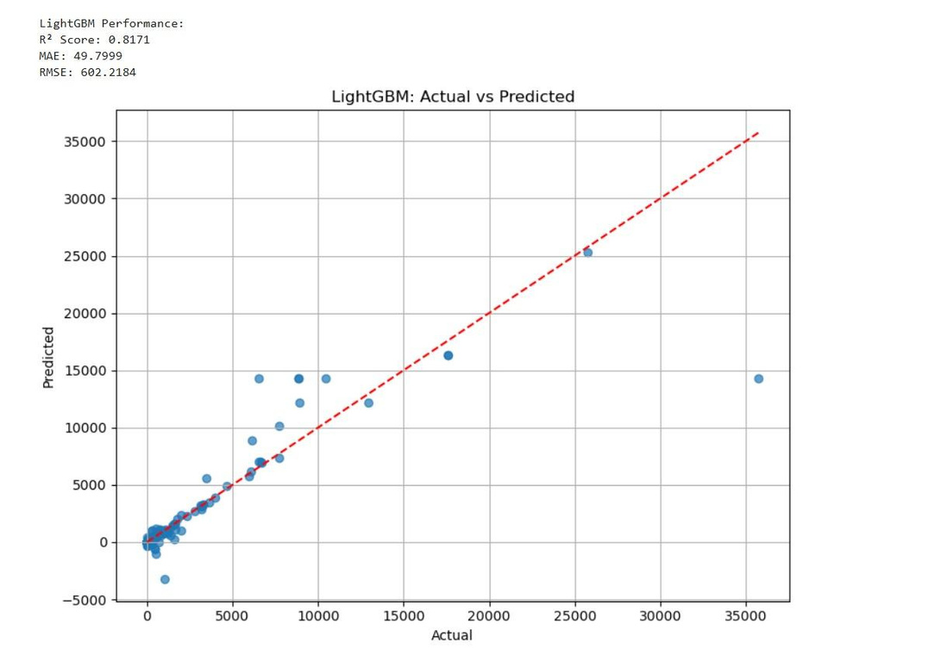
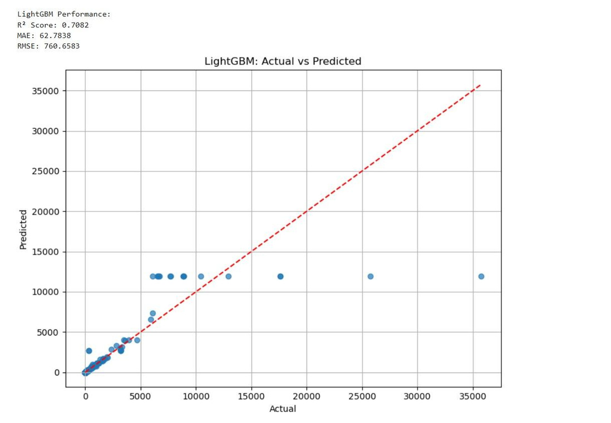
Light GBM
Before Tuning
After Tuning
Notes:
N estimator 1500
N estimator 1000 also tried changing features

Slide 18
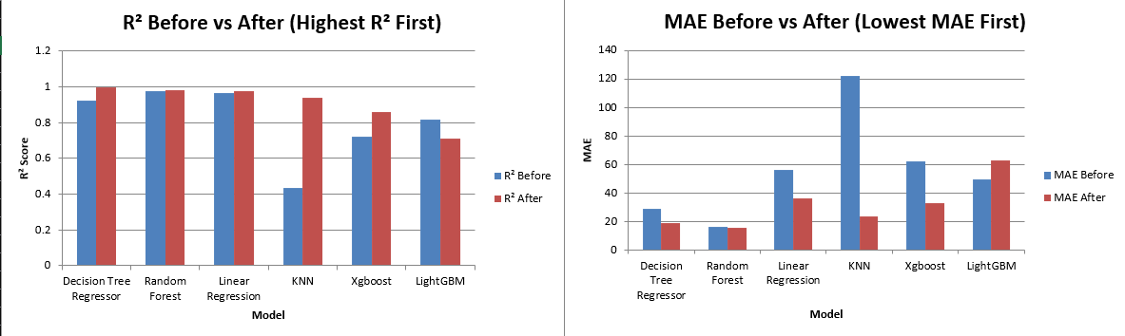
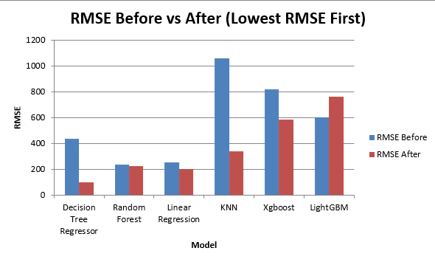
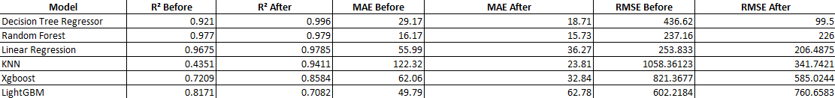
Comparison of models
Notes:
“This slide summarizes the performance of all our machine learning models, both before and after tuning.
Starting with the R² chart, we can see that Decision Tree Regressor achieved the highest R² after tuning, followed closely by Random Forest and Linear Regression, indicating strong predictive power.
In terms of MAE and RMSE, which represent the error margins, Decision Tree again had the lowest post-tuning RMSE at around 99, while Random Forest also showed competitive error values, confirming their stability.
Interestingly, while LightGBM is powerful in general, in our case, they performed better before tuning, so we chose to retain the original versions.
Overall, this comparison helped us conclude that Decision Tree and Random Forest are our most reliable models for predicting 2022 drug spending per dosage unit.”

Slide 19
Thank you!

